Slide 1

HOME-BASED SERVICES PROGRAM
Presented by Lisa Lew
Clearbrook
January 9th, 2015

Slide 2
Clearbrook: How it all began
1955:
5 families in a church basement
1960s: Vocational Services
1970s: Residential Services and CHILD Program
1980s: Expansion of Residential Services
1990s: Clearbrook Clinic, CILA, Respite, and CFC
2000: Plaza opens, HBS expands
Largest provider of home-based services in IL
6000 served in 13 counties

Slide 3
Clearbrook Today
We serve individuals throughout their lifespan.
Children’s Services
Adult
Day and Residential Services
Senior Services
Home-Based Services
Clinical Services

Slide 4

Family & Community Autism Resource Rooms
http://www.clearbrook.org/page.aspx?pid=430
Provides autism resources that include consultation, visual
communication systems, and a vast library resources at no cost.
Two locations: Arlington Heights and Northbrook
Arlington Heights is open Monday, Tuesday, & Thursday from 8:30am-3pm
Wednesday, Friday, evening & weekend hours are also available by
appointment.
Northbrook is currently open by appointment only.
For additional information, contact
Tracy Hellner, Autism Resource Specialist, 847-392-2812 ext 31
thellner@clearbrook.org

Slide 5
Transition Services: Building Bridges
http://www.clearbrook.org/page.aspx?pid=373
Assists families and professionals in transitioning students with intellectual/developmental disabilities to the world of adult services. The following six agencies use a collaborative approach to serve these individuals: Clearbrook, Elim Christian Services, Helping Hand Center, PACTT Learning Center, Park Lawn Services and Seguin Services.
Who is served by Building Bridges?
Students aged 14 through 25 with a intellectual/developmental disability, and their families.
Provides assistance in these areas:
Entry into Developmental Disabilities system (PAS, PUNS)
Financial/Medical Benefits (SSI, Medicaid)
Legal Resources (Guardianship, Special Needs Trust, Power of Attorney, Wills)
Program Funding (Waivers, Residential Program, Day Program, DORS)
Training/Coaching (Parent Education & Support, Options for Community Services, Self-Advocacy)
For additional information, contact Michelle Schwartz, Transition Outreach Specialist
847-385-5354 or mschwartz@clearbrook.org

Slide 6
Clearbrook Programs: Adult Services
Children’s Services
Adult Day and Residential Services
Senior Services
Home-Based Services
Clinical Services

Slide 7
ADULT DAY SERVICES
  http://www.clearbrook.org/page.aspx?pid=377
  Developmental Training (DT)- Schaumburg, Gages Lake & Palatine
  Autism Day Services (CAP)- Palatine & Northbrook
  Senior Day Services (ACES)- Rolling Meadows
  Employment & Training- Arlington Heights & Palatine
  CHOICE Program- Evanston
  PURSUIT Program- Rolling Meadows
  Partners in Adult Learning (PAL) Program- Palatine
  For additional information contact the Admissions Department:
  Melinda Meyer 847-385-5328 mmeyer@clearbrook.org
  Tracy Martin 847-385-5018 tmartin@clearbrook.org

Slide 8

Home-Based Services Program (HBS)
http://www.clearbrook.org/programs/homebased
This program provides active treatment based services to children and adults with intellectual/developmental disabilities and their family.
The Program:
Provides support in the comfort and familiarity of a home,
educational setting and/or community environment.
Provides services to promote skill development and
community integration.
Coordinates with other programs in which family members
may participate.
  Offices in Arlington Heights, Northbrook and Downers Grove
Currently serves over 1000 individuals in 13 Illinois counties.
For additional information, contact Hollis Gorrie, Program Director at 847-385-5041 or hgorrie@clearbrook.org.

Slide 9
Adult Residential Services
Intermediate Care Facilities for Individuals with Intellectual/Developmental (ICF/IID)
• Lattof Commons (92 clients, Rolling Meadows)
• Fairfax (16 clients, all male, Rolling Meadows)
• Wilke (16 clients, all female, Rolling Meadows)
• Wright Home (16 clients, Gurnee)
Community Integrated Living Arrangement (CILA)
• 35 locations throughout the north & northwest suburbs and the city of Chicago
For additional information, please contact Admissions:
Melinda Meyer 847-385-5328 mmeyer@clearbrook.org
Tracy Martin 847-385-5018 tmartin@clearbrook.org

Slide 10
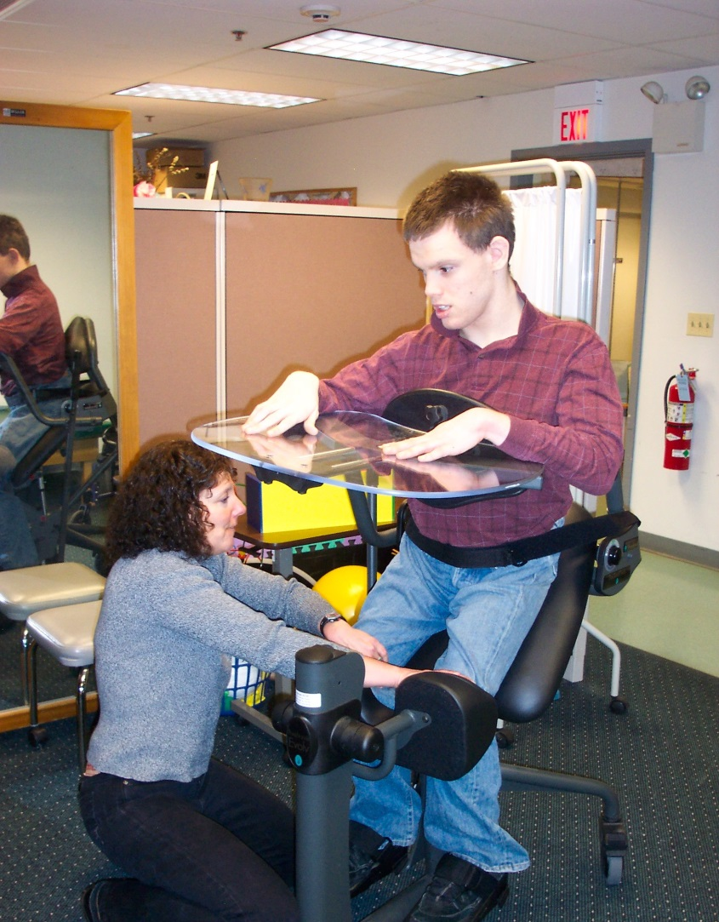
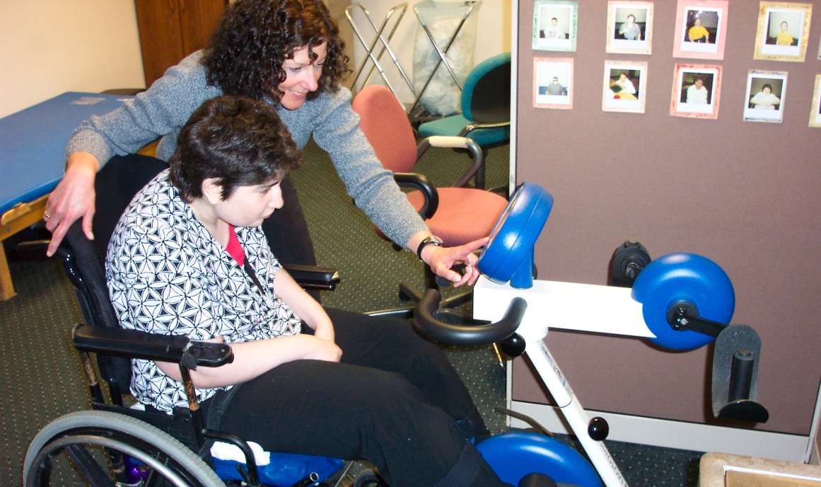
Adult Clinical & Behavior Services

Slide 11
ADULT CLINICAL & BEHAVIOR SERVICES
http://www.clearbrook.org/page.aspx?pid=376
Behavioral Services
Psychological/Counseling Services
Speech Therapy
Occupational Therapy
Physical Therapy
Medical Consultation
For additional information, contact Mark Ammer, BCBA, Director of Clinical Services at 847-310-9141 ext. 231 or mammer@clearbrook.org

Slide 12

What are the
Home-Based Support Programs?
Children’s Home-Based Support
Adult Home-Based Support
Waivers

Slide 13
What is a Waiver?
The Children’s and Adult Home-Based Support Services Programs (HBSS) for people with developmental/intellectual disabilities are both part of “waiver” programs.

Slide 14
A waiver means they are funded with a mix of funding from the State of Illinois and the Federal Government. The State of Illinois pays the providers of supports and services. Then the Federal Government reimburses the State 50 cents for every dollar they have spent. In other words, they each pay half.
STATE
FEDERAL

Slide 15
Waivers allow states to design programs for special populations using Medicaid.
Most adults with severe disabilities have low
income and qualify for Medicaid
Illinois has agreed to ignore the income
requirement for families of minor children in the
HBSSP

Slide 16
What’s the scoop on this 1115 Medicaid Transformation
Waiver I keep hearing about?
In Illinois, home and community-based services are compartmentalized under nine separate waivers, three departments and numerous divisions within departments.
Savings derived from merging the nine waivers will be reinvested into rebuilding the Home & Community Based System, especially in Behavioral Health and Developmental Disabilities.
https://www2.illinois.gov/gov/healthcarereform/Pages/1115Waiver.aspx

Slide 17
What’s the scoop on this 1115 Medicaid Transformation
Waiver I am hearing about?
Specifically, Illinois seeks to accomplish the following through the Path to Transformation Waiver:
• Rationalize service arrays and choices so that they are based on beneficiary needs
and preferences to remain as independent as possible, rather than disability or
condition
• Increase flexibility and choice for beneficiaries
• Support development and expansion of community based options
• Reduce waiting lists for waiver services
• Develop outcome-based reimbursement strategies that emphasize quality of care and
align payments with the goals of the program
• Reduce administrative complexity and cost inherent in managing nine separate
waivers

Slide 18
The Application Process
DHS selects adults and children for new enrollment from the PUNS (Prioritization of Urgency of Need for Services) database.
You can get more information on the PUNS Selection Process from the DHS Website
http://www.dhs.state.il.us/page.aspx?item=41131
Urgency of Need
Length of time on database
Statewide geographic distribution
Current living arrangement
Caregiver situation
Notes:
Refer to your local Independent Service Coordination agency (CAU) to get on the PUNS List

Slide 19
LIGAS CONSENT DECREE
Signed in 2011
Guarantees that, over the next 6 years, all persons currently living in ICFDDs who wish to move out into CILAs (or home-based services) may do so.
Guarantees that, over the next 6 years, the State will provide CILA or home-based services to 3,000 ADULTS now living at home.

Slide 20
LIGAS UPDATE
Third Annual Report of the Ligas Court Monitor (9-30-14) http://www.dhs.state.il.us/page.aspx?item=74367
In summary, 4,306 letters have been sent to Ligas waiting list class members over the past three years.
As of September 1, 2014, the status of provision of services for those individuals found eligible as waiting list class members is as follows:
Services have been initiated for 1,969 class members.
An additional 89 class members have received funding awards, and services are about to begin soon.
Packets for another 24 individuals have been completed, and sent to DHS for funding approval.
499 individuals are in the process of receiving or have completed Level II screening by PAS agencies, and requests are being processed.
Initial contact has been made with an additional 146 individuals who have confirmed that they have requested services.

Slide 21
If Selected….
Must Have
Medicaid
Clinical Waiver
Eligibility Criteria

Slide 22
Waiver Clinical Eligibility Criteria for Adult’s with a Developmental Disability
18 or older
Resident of Illinois and living in Illinois
Enrolled in Medicaid in Illinois
Have a developmental disability, either mental retardation or related condition
determined disabled according to the provisions of Title II of the Social Security Act, Federal Old-Age, Survivors and Disability Insurance Benefits (42 U.S.C. 421).
Eligible for ICF/MR level of service
Not in need of nursing assessment, monitoring, intervention & supervision of their condition or needs on a 24 hour basis
not be receiving services in a nursing facility, skilled nursing facility, Intermediate Care Facility for people with Developmental Disabilities (ICF/DD), state-operated facility, skilled nursing facility for pediatrics, hospice facility, sheltered care facility, assisted living facility or hospital.
Not receiving services funded by another Medicaid Waiver program
Notes:
ICF/MR- MR before 18, substantial deficits in 3 out of 6 major life area’s (if related condition), need active treatment

Slide 23

THE AWARD LETTER
Services can begin once you
receive the award letter
Effective date is listed on the letter

Slide 24
Now What?
            Contact your Service Facilitator
            Schedule a HOME VISIT
            Learn about the Program

Slide 25
What’s a SERVICE FACILITATOR?
Service facilitation includes case management services that assist participants and families in gaining access to needed Waiver and other Medicaid State Plan services, as well as medical, social, educational and other services, regardless of the funding source for the services.
Service Facilitators are responsible for day-to-day oversight and administration of the service plan and for ensuring participant health, safety and welfare.

Slide 26
How do I find a Service Facilitator?
Get List from PAS/ISC Agency
Interview Agencies
Select a Provider

Slide 27
THE PROCESS
Identify Needs
Monthly Budgeting
Write a Service Plan
Find Services

Slide 28
Identify Needs
Child/Adult
Family Members
ISSA
Service Facilitator
Other Providers
WRITE A SERVICE PLAN

Slide 29
What’s a Service Plan?
A written plan to identify the supports and services the individual
needs and wants
Goals are written to assist the individual to live successfully in the
community
Ensure providers understand and fulfill their roles and responsibilities
Ensure funds are used in the best interest of the individual.
The process must be as simple as possible so that all participants can
understand their roles

Slide 30
Service plans are completed within 30 days of service initiation and updated at least annually by the service planning team. They should also be reviewed and revised as needed by the
Service Facilitator.
Services Provided
Adjust ISP
Monitor goals

Slide 31
SERVICE PLANS ARE IMPORTANT
NO SERVICE PLAN
NO SERVICES

Slide 32
BUDGETING
How much funding is available?
The amount is equal to two times whatever SSI is that year.
Currently SSI is $721 / 2015= $733
Children’s
19-22
Still in school
If the participant is still in school, he or she has access to supports and services with a cost of up to two times SSI.
Children’s monthly allocation of HB funds is $1,442/ 2015= $1466 ($24 increase)
$1,442/ 2015= $1466 ($24 increase)
Children’s
3-18 years old
The amount is equal to three times whatever SSI is that year.
Currently SSI is $721/2015= $733
Adult monthly allocation of HB funds is
$2,163/2015=$2199 ($36 increase)
Adult
18 and older

Slide 33
DDD Waiver Manual https://www.dhs.state.il.us/page.aspx?item=45227
Introduction
Participant Eligibility and Waiver Program Enrollment
Waiver Services
Table - Available Services by Waiver Program
Individual Service Plan
Self-Directed Services and Individual Budgeting
Provider Requirements
Provider Enrollments and Qualifications
Summary of Specific Provider Qualifications and Credentials
Service Authorization and Prior Approval
Waiver Service Rates
Waiver Service Billing Guidance
Billing Guidance by Service Type
Appendices (Forms and Instructions)

Slide 34
What Service’s are Covered?
Service | Adult Waiver | Children’s Support
 | HBS | Waiver
IND. SERVICE & SUPPORT ADVOCACY | X | X
DAY HABILITAITON & OTHER DAY PROGRAM SERVICES
Developmental Training (DT) | X
Temporary Intensive Staffing * | In DT Only
Supported Employment (SEP) * | X
Adult Day Care * | X
Regular Work/Sheltered Employment | X
Other Day Program *
BEHAVIOR SERVICES
Behavior Intervention and Treatment | X | X
Behavior Counseling | X
Psychotherapy | X
THERAPIES
Physical Therapy * + | X
Occupational Therapy * + | X
Speech Therapy * + | X
ADAPTIVE EQUIPMENT, ASSISTIVE TECHNOLOGY, VEHICLE MODIFICATIONS, HOME ACCESSIBILITY MODIFICATIONS *
Adaptive equipment * | X | X
Assistive Technology * | X | X
Home Accessibility Modifications * | X | X
Vehicle modifications * # | X | X
HOME-BASED SUPPORT SERVICES
Service Facilitation | X | X
Personal Support | X | X
Temporary Assistance * | X | X
Nursing + | X
Emergency Home Response Services | X
Transportation (Non-Medical) | X
Training and Counseling Services for Unpaid Caregivers | X | X
Out-of-Home Respite (89D) | X | X
* Services that require both authorization and prior approval are marked with an asterisk.
# Vehicle Modifications are part of the transportation component of the residential rate.
+ These services are available for children up to age 19 21 through the Medicaid State Plan.

Slide 35
DDD FY13 Rates Table - Effective October 1, 2012
DDD PROGRAM NAME | Program Code | HCB Medicaid Waiver | Service Unit Type | Maximum Per FY | FY2013 Rate | FY2013 Rate
DAY PROGRAMS - POS (Any combination of Day Program codes can be a maximum of 1,100)
Developmental Training | 31U | Y | Client Hour | 1,100 | $10.39 | $11,427
Developmental Training - Advance & Reconcile (No new authorizations) | 31A | Y | Client Hour | 1,100 | $10.39 | $11,427
Regular Work | 38U | N | Client Hour | 1,100 | $10.39 | $11,427
Supported Emp. (Group) No Job Coach | 36G | Y | Client Hour | 1,100 | $11.63 | $12,790
Supported Emp. (Group) Job Coach | 39G | Y | Client Hour | 1,100 | $11.63 | $12,790
Supported Emp. (Indiv.) No Job Coach | 36U | Y | Client Hour | 1,100 | $13.03 | $14,337
Supported Emp. (Indiv.) Job Coach | 39U | Y | Client Hour | 1,100 | $13.03 | $14,337
Adult Day Care | 35U | Y | Client Hour | 1,100 | $12.34 | $13,574
Other Day Program | 30U | N | Client Hour | 1,100 | $10.39 | $11,427
At-Home Day Program | 37U | Y | Client Hour | 1,100 | $10.39 | $11,427
WAIVER SUPPORT
Indiv Serv & Support Advocacy (ISSA) | 50D | Y - Admin. | Client Hour | 25 | $40.01 | $1,000
THERAPIES
Physical Therapy | 52P | Y | Client Hour | 52 | $36.00 | $1,872
Occupational Therapy | 52O | Y | Client Hour | 52 | $36.00 | $1,872
Speech Therapy | 52S | Y | Client Hour | 52 | $36.00 | $1,872

Slide 36
DDD FY13 Rates Table - Effective October 1, 2012
Behavior Intervention and Treatment | 56U
Level 1 - Licensed Professional - Statewide Rate | L1 | Y | Hour | 66 (Any combination of L1 & L2) | $77.86 | $5,139
Level 2 - Other Credentials or No Level Specified - Statewide Rate | L2 | Y | Hour | 66 (Any combination of L1 & L2) | $62.28 | $4,110
Individual Counseling | 57U | Y | Client Hour | 60 (Any combination of 57U, 57G, 58U, 58G) | $30.57 | $1,834
Group Counseling | 57G | Y | Client Hour | 60 (Any combination of 57U, 57G, 58U, 58G) | $10.19 | $611
Individual Therapy | 58U | Y | Client Hour | 60 (Any combination of 57U, 57G, 58U, 58G) | $38.21 | $2,292
Group Therapy | 58G | Y | Client Hour | 60 (Any combination of 57U, 57G, 58U, 58G) | $12.74 | $764
HOME-BASED SUPPORTS
HBS Service Facilitator (children & adults) | 55A | Y | Hour | 24 or 2/Mo. Min. | $40.01 | Annual Max. $$
HBS Training for Unpaid Caregivers (children & adults) | 55B | Y | Event | Mo. Max. | varies | Annual Max. $$
HBS Counseling for Unpaid Caregivers (children & adults) | 55C | Y | Hour | Mo. Max. | $30.57 | Annual Max. $$
HBS Personal Support (children & adults) | 55D | Y | Event | Mo. Max. | varies | Annual Max. $$
HBS Nursing - Registered Nurse (adults only) | 55N | Y | Hour | 365 or Mo.Max $$ | $31.90 | Annual Max. $$
HBS Nursing - Licensed Practical Nurse (adults only) | 55P | Y | Hour | 365 or Mo.Max $$ | $28.90 | Annual Max. $$

Slide 37
DDD FY13 Rates Table - Effective October 1, 2012
HBS Transportation (adults only) | 55T | Y | Events/Miles | $500/Mo. | $0.38 | Annual Max. $$
HBS Emergency Home Response (adults only) | 55W
Level 1 - System Installation | L1 | Y | Event | 1/State FY | $30.75 | $31
Level 2 - Monthly Rate for Monitoring | L2 | Y | Event | 1/Month | $28.70 | Annual Max. $$
OTHER SUPPORTS AND SERVICES
Crisis Services (Adult HBS only) | 53C | Y | Hour | 60 Consecutive Days | varies | varies
Adaptive Equipment | 53E | Y | Event | $15,000/5 Yr. Max (Any combination of 53E, 53T, 53H, 53V) | varies | varies
Assistive Technology | 53T | Y | Event | $15,000/5 Yr. Max (Any combination of 53E, 53T, 53H, 53V) | varies | varies
Minor Home Accessibility Modification | 53H | Y | Event | $15,000/5 Yr. Max (Any combination of 53E, 53T, 53H, 53V) | varies | varies
Temporary Intensive Staffing - Day (DT only) | 53D | Y | Hour | Tied to DSP wage rate | $12.86 | varies
Temporary Intensive Staffing - Residential (60D only) | 53R | Y | Hour | Tied to DSP wage rate | $12.86 | varies
Minor Vehicle Accessibility Modification | 53V | Y | Event | $15,000/5 Yr. Max (Any combination of 53E, 53T, 53H, 53V) | varies | varies
Service Facilitation - HBSS MH Adults | 69B | N | Hour | 48 | $40.01 | $1,921

Slide 38
Department of Human Service (DHS)
Developmental Disabilities Services (DDD) https://www.dhs.state.il.us/page.aspx?item=29733
Life Choices Project - What is this All About?
Home-Based Support Fiscal/Employer Agency Change
How Do I Apply?
Search the DHS Office Locator for the PAS/ISC agency closest to you. https://www.dhs.state.il.us/page.aspx?module=12&officetype=&county=
What Services May Be Available?
  Residential Living Arrangements
  In-Home Supports
  Day Services
  Other Supports
  Support Service Teams
Provider Information
  Provider Information: Provider by Service Type, Reviews, Administrative Actions
  Developmental Disabilities Waiver Providers by Program Type
More Information & Resources
  Family & Care Giver Resources
  Ligas
  DDD Information Bulletins
  Disability Resources

Slide 39
Family Support Network
Frequently Asked Questions
Regarding the Children and Adult Home-Based Support Services Programs
*Updated February 2014
http://familysupportnetwork.org/wp-content/uploads/2014/02/HBSSP-FAQ-2014.pdf

Slide 40

Lisa Lew
Clearbrook
Home Based Services Program
847-778-3675
llew@clearbrook.org

